Slide 1
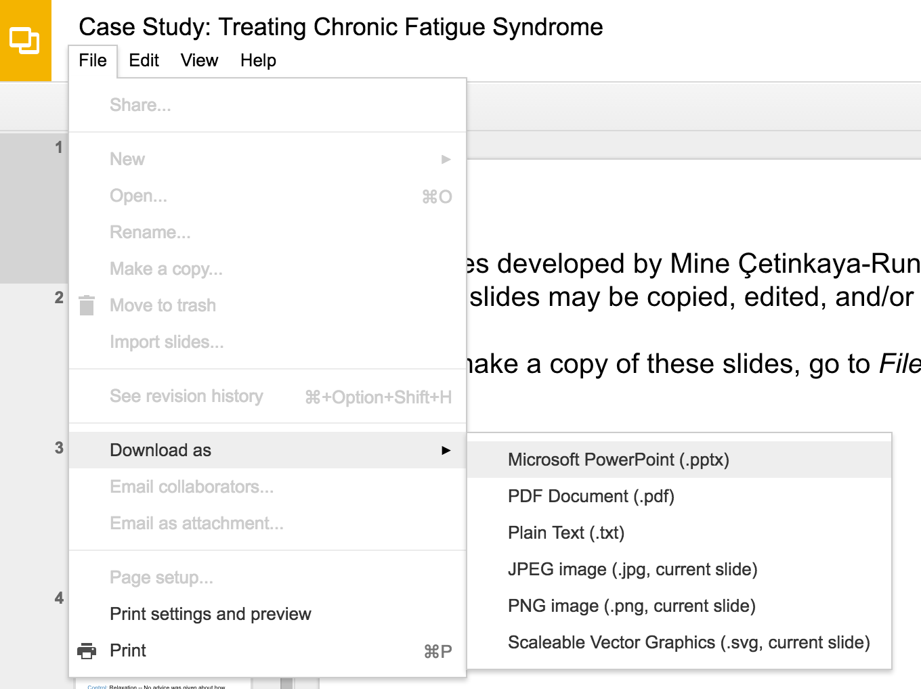
Slides developed by Mine Çetinkaya-Rundel of OpenIntro
Translated from LaTeX to Google Slides by Curry W. Hilton of OpenIntro.
The slides may be copied, edited, and/or shared via the CC BY-SA license
To make a copy of these slides, go to File > Download as > [option], as shown below. Or if you are logged into a Google account, you can choose Make a copy... to create your own version in Google Drive.

Slide 2
Difference of
Two Proportions

Slide 3
Melting ice cap
Scientists predict that global warming may have big effects on the polar regions within the next 100 years. One of the possible effects is that the northern ice cap may completely melt. Would this bother you a great deal, some, a little, or not at all if it actually happened?
A great deal
Some
A little
Not at all

Slide 4
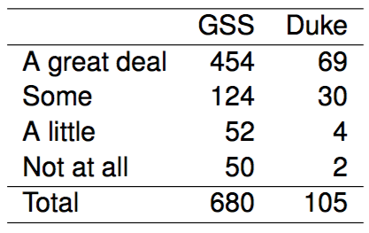
Results from the GSS
The GSS asks the same question, below are the distributions of responses from the 2010 GSS as well as from a group of introductory statistics students at Duke University:

Slide 5
Parameter and point estimate
Parameter of interest: Difference between the proportions of all Duke students and all Americans who would be bothered a great deal by the northern ice cap completely melting.
p_{Duke} - p_{US}

Slide 6
Parameter and point estimate
Parameter of interest: Difference between the proportions of all Duke students and all Americans who would be bothered a great deal by the northern ice cap completely melting.
p_{Duke} - p_{US}
Point estimate: Difference between the proportions of sampled Duke students and sampled Americans who would be bothered a great deal by the northern ice cap completely melting.
p̂_{Duke} - p̂_{US}

Slide 7
Inference for comparing proportions
The details are the same as before…

Slide 8
Inference for comparing proportions
The details are the same as before…
CI: point estimate ± margin of error

Slide 9
Inference for comparing proportions
The details are the same as before…
CI: point estimate ± margin of error
HT: Use Z = (point estimate - null value) / SE to find appropriate p-value.

Slide 10

Inference for comparing proportions
The details are the same as before…
CI: point estimate ± margin of error
HT: Use Z = (point estimate - null value) / SE to find appropriate p-value.
We just need the appropriate standard error of the point estimate , which is the only new concept.

Slide 11

Inference for comparing proportions
The details are the same as before…
CI: point estimate ± margin of error
HT: Use Z = (point estimate - null value) / SE to find appropriate p-value.
We just need the appropriate standard error of the point estimate , which is the only new concept.
Standard error of the difference between two sample proportions

Slide 12
Conditions for CI for difference of proportions
Independence within groups:
The US group is sampled randomly and we're assuming that the Duke group represents a random sample as well.

Slide 13
Conditions for CI for difference of proportions
Independence within groups:
The US group is sampled randomly and we're assuming that the Duke group represents a random sample as well.
n_{Duke} < 10% of all Duke students and 680 < 10% of all Americans.

Slide 14
Conditions for CI for difference of proportions
Independence within groups:
The US group is sampled randomly and we're assuming that the Duke group represents a random sample as well.
n_{Duke} < 10% of all Duke students and 680 < 10% of all Americans.
We can assume that the attitudes of Duke students in the sample are independent of each other, and attitudes of US residents in the sample are independent of each other as well.

Slide 15
Conditions for CI for difference of proportions
Independence within groups:
The US group is sampled randomly and we're assuming that the Duke group represents a random sample as well.
n_{Duke} < 10% of all Duke students and 680 < 10% of all Americans.
We can assume that the attitudes of Duke students in the sample are independent of each other, and attitudes of US residents in the sample are independent of each other as well.
Independence between groups: The sampled Duke students and the US residents are independent of each other.

Slide 16
Conditions for CI for difference of proportions
Independence within groups:
The US group is sampled randomly and we're assuming that the Duke group represents a random sample as well.
n_{Duke} < 10% of all Duke students and 680 < 10% of all Americans.
We can assume that the attitudes of Duke students in the sample are independent of each other, and attitudes of US residents in the sample are independent of each other as well.
Independence between groups: The sampled Duke students and the US residents are independent of each other.
Success-failure: At least 10 observed successes and 10 observed failures in the two groups.

Slide 17
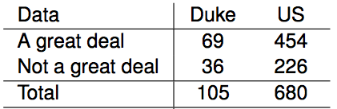
Sample proportions are also nearly normally distributed
Construct a 95% confidence interval for the difference between the proportions of Duke students and Americans who would be bothered a great deal by the melting of the northern ice cap (p_{Duke} - p_{US}).

Slide 18
Sample proportions are also nearly normally distributed
Construct a 95% confidence interval for the difference between the proportions of Duke students and Americans who would be bothered a great deal by the melting of the northern ice cap (p_{Duke} - p_{US}).

Slide 19

Sample proportions are also nearly normally distributed
Construct a 95% confidence interval for the difference between the proportions of Duke students and Americans who would be bothered a great deal by the melting of the northern ice cap (p_{Duke} - p_{US}).

Slide 20

Sample proportions are also nearly normally distributed
Construct a 95% confidence interval for the difference between the proportions of Duke students and Americans who would be bothered a great deal by the melting of the northern ice cap (p_{Duke} - p_{US}).

Slide 21
Sample proportions are also nearly normally distributed
Construct a 95% confidence interval for the difference between the proportions of Duke students and Americans who would be bothered a great deal by the melting of the northern ice cap (p_{Duke} - p_{US}).

Slide 22
Sample proportions are also nearly normally distributed
Construct a 95% confidence interval for the difference between the proportions of Duke students and Americans who would be bothered a great deal by the melting of the northern ice cap (p_{Duke} - p_{US}).

Slide 23
Sample proportions are also nearly normally distributed
Construct a 95% confidence interval for the difference between the proportions of Duke students and Americans who would be bothered a great deal by the melting of the northern ice cap (p_{Duke} - p_{US}).

Slide 24


Sample proportions are also nearly normally distributed
Construct a 95% confidence interval for the difference between the proportions of Duke students and Americans who would be bothered a great deal by the melting of the northern ice cap (p_{Duke} - p_{US}).

Slide 25
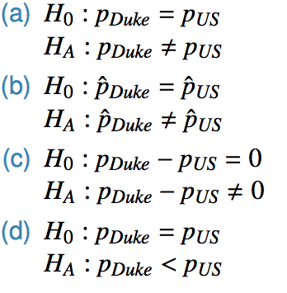
Practice
Which of the following is the correct set of hypotheses for testing if the proportion of all Duke students who would be bothered a great deal by the melting of the northern ice cap differs from the proportion of all Americans who do?

Slide 26
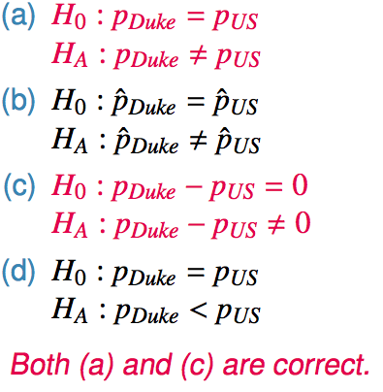
Practice
Which of the following is the correct set of hypotheses for testing if the proportion of all Duke students who would be bothered a great deal by the melting of the northern ice cap differs from the proportion of all Americans who do?

Slide 27
Flashback to working with one proportion
When constructing a confidence interval for a population proportion, we check if the observed number of successes and failures are at least 10. np̂ ≥ 10 n * (1 - p̂) ≥10

Slide 28
Flashback to working with one proportion
When constructing a confidence interval for a population proportion, we check if the observed number of successes and failures are at least 10. np̂ ≥ 10 n * (1 - p̂) ≥10
When conducting a hypothesis test for a population proportion, we check if the expected number of successes and failures are at least 10. np₀ ≥ 10 n * (1 - p₀) ≥ 10

Slide 29
Pooled estimate of a proportion
In the case of comparing two proportions where H₀: p₁ = p₂, there isn't a given null value we can use to calculated the expected number of successes and failures in each sample.

Slide 30
Pooled estimate of a proportion
In the case of comparing two proportions where H₀: p₁ = p₂, there isn't a given null value we can use to calculated the expected number of successes and failures in each sample.
Therefore, we need to first find a common (pooled) proportion for the two groups, and use that in our analysis.

Slide 31

Pooled estimate of a proportion
In the case of comparing two proportions where H₀: p₁ = p₂, there isn't a given null value we can use to calculated the expected number of successes and failures in each sample.
Therefore, we need to first find a common (pooled) proportion for the two groups, and use that in our analysis.
This simply means finding the proportion of total successes among the total number of observations.
Pooled estimate of a proportion

Slide 32
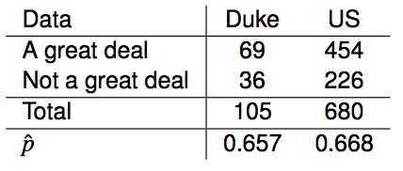
Practice
Calculate the estimated pooled proportion of Duke students and Americans who would be bothered a great deal by the melting of the northern ice cap. Which sample proportion (p̂_{Duke} or p̂_{US}) the pooled estimate is closer to? Why?

Slide 33

Practice
Calculate the estimated pooled proportion of Duke students and Americans who would be bothered a great deal by the melting of the northern ice cap. Which sample proportion (p̂_{Duke} or p̂_{US}) the pooled estimate is closer to? Why?

Slide 34
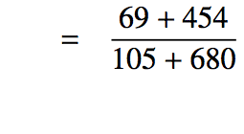
Practice
Calculate the estimated pooled proportion of Duke students and Americans who would be bothered a great deal by the melting of the northern ice cap. Which sample proportion (p̂_{Duke} or p̂_{US}) the pooled estimate is closer to? Why?

Slide 35

Practice
Calculate the estimated pooled proportion of Duke students and Americans who would be bothered a great deal by the melting of the northern ice cap. Which sample proportion (p̂_{Duke} or p̂_{US}) the pooled estimate is closer to? Why?

Slide 36

Practice
Calculate the estimated pooled proportion of Duke students and Americans who would be bothered a great deal by the melting of the northern ice cap. Which sample proportion (p̂_{Duke} or p̂_{US}) the pooled estimate is closer to? Why?

Slide 37
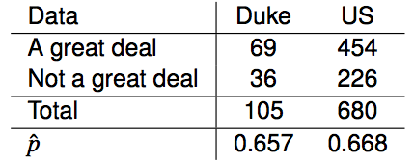
CI vs. HT for proportions
Do these data suggest that the proportion of all Duke students who would be bothered a great deal by the melting of the northern ice cap differs from the proportion of all Americans who do? Calculate the test statistic, the p-value, and interpret your conclusion in context of the data.

Slide 38
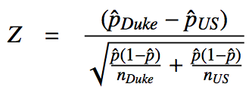
CI vs. HT for proportions
Do these data suggest that the proportion of all Duke students who would be bothered a great deal by the melting of the northern ice cap differs from the proportion of all Americans who do? Calculate the test statistic, the p-value, and interpret your conclusion in context of the data.

Slide 39
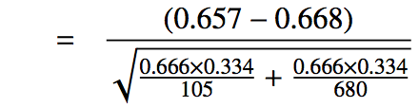
CI vs. HT for proportions
Do these data suggest that the proportion of all Duke students who would be bothered a great deal by the melting of the northern ice cap differs from the proportion of all Americans who do? Calculate the test statistic, the p-value, and interpret your conclusion in context of the data.

Slide 40
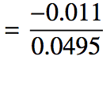
CI vs. HT for proportions
Do these data suggest that the proportion of all Duke students who would be bothered a great deal by the melting of the northern ice cap differs from the proportion of all Americans who do? Calculate the test statistic, the p-value, and interpret your conclusion in context of the data.

Slide 41
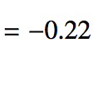
CI vs. HT for proportions
Do these data suggest that the proportion of all Duke students who would be bothered a great deal by the melting of the northern ice cap differs from the proportion of all Americans who do? Calculate the test statistic, the p-value, and interpret your conclusion in context of the data.

Slide 42
CI vs. HT for proportions
Do these data suggest that the proportion of all Duke students who would be bothered a great deal by the melting of the northern ice cap differs from the proportion of all Americans who do? Calculate the test statistic, the p-value, and interpret your conclusion in context of the data.

Slide 43
Recap - comparing two proportions
Population parameter: (p₁ - p₂), point estimate: (p̂₁ - p̂₂)

Slide 44
Recap - comparing two proportions
Population parameter: (p₁ - p₂), point estimate: (p̂₁ - p̂₂)
Conditions:

Slide 45
Recap - comparing two proportions
Population parameter: (p₁ - p₂), point estimate: (p̂₁ - p̂₂)
Conditions:
independence within groups - random sample and 10% condition met for both groups
independence between groups
at least 10 successes and failures in each group - if not → randomization (Section 6.4)

Slide 46


Recap - comparing two proportions
Population parameter: (p₁ - p₂), point estimate: (p̂₁ - p̂₂)
Conditions:
independence within groups - random sample and 10% condition met for both groups
independence between groups
at least 10 successes and failures in each group - if not → randomization (Section 6.4)
for CI: use p̂₁ and p̂₂
for HT:
when H₀: p₁ = p₂: use
when H₀: p₁ - p₂ = (some value other than 0): use p̂₁ and p̂₂ - this is pretty rare

Slide 47
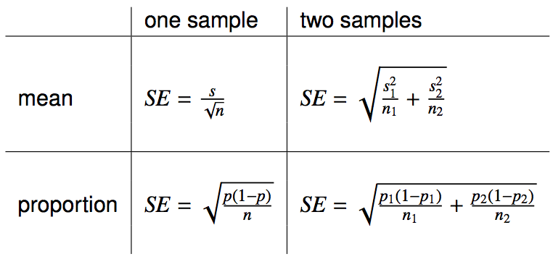
Reference - standard error calculations

Slide 48
Reference - standard error calculations
When working with means, it's very rare that σ is known, so we usually use s.

Slide 49
Reference - standard error calculations
When working with means, it's very rare that σ is known, so we usually use s.
When working with proportions,
if doing a hypothesis test, p comes from the null hypothesis
if constructing a confidence interval, use p̂ instead

Slide 50
Find more resources at openintro.org/os, including
Slides
Videos
Statistical Software Labs
Discussion Forums (free support for students and teachers)
Learning Objectives
Teachers only content is also available for Verified Teachers, including
Exercise solutions
Sample exams
Ability to request a free desk copy for a course
Statistics Teachers email group
Questions? Contact us.

